Slide 1

3-D Poisson’s equation using non-stationary iterative method
HBM 514E - Parallel Numerical Algorithms and Tools
Valentin L’HOMEL
922110009

Slide 2
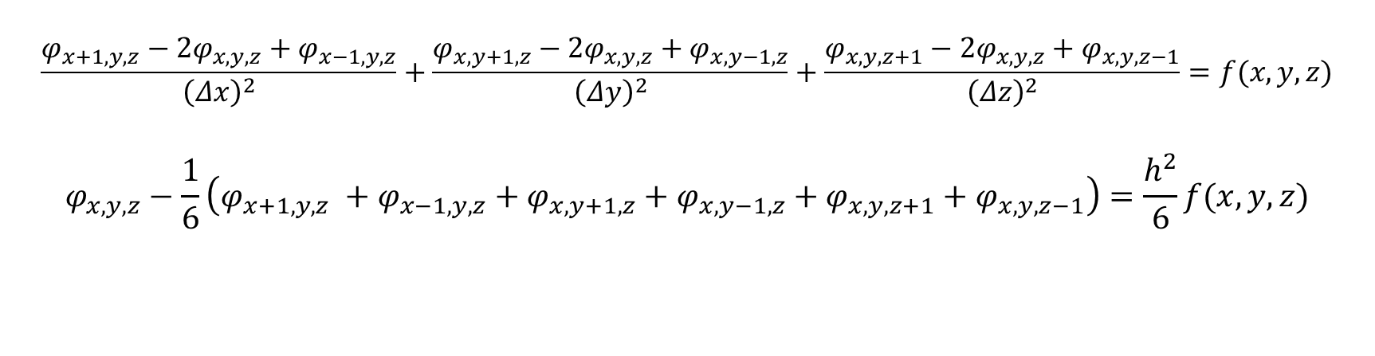

3-D Poisson’s equation
$$\left(\frac{δ^{2}}{δx^{2}}+\frac{δ^{2}}{δy^{2}}+\frac{δ^{2}}{δz^{2}}\right)φ(x,y,z)=f\left(x,y,z\right)$$
$$\frac{φ_{x+1,y,z}−2φ_{x,y,z}+φ_{x−1,y,z}}{{\left(Δx\right)}^{2}}+\frac{φ_{x,y+1,z}−2φ_{x,y,z}+φ_{x,y−1,z}}{{\left(Δy\right)}^{2}}+\frac{φ_{x,y,z+1}−2φ_{x,y,z}+φ_{x,y,z−1}}{{\left(Δz\right)}^{2}}=f(x,y,z)$$
$$φ_{x,y,z}−\frac{1}{6}\left(φ_{x+1,y,z} +φ_{x−1,y,z}+φ_{x,y+1,z}+φ_{x,y−1,z}+φ_{x,y,z+1}+φ_{x,y,z−1}\right)=\frac{h^{2}}{6}f(x,y,z)$$

Slide 3
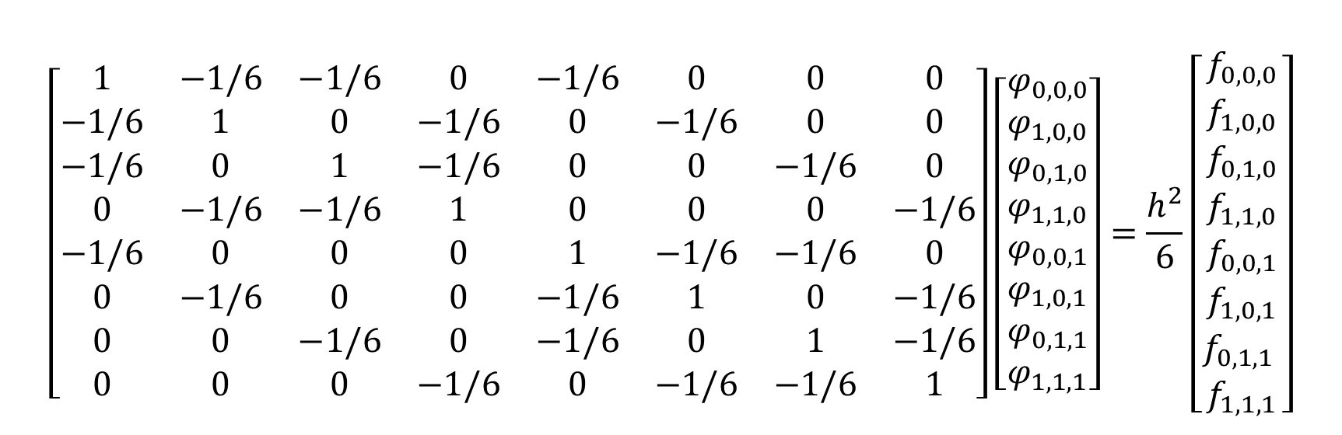
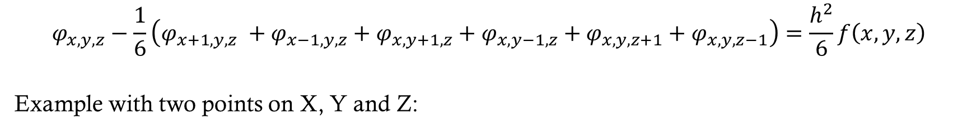
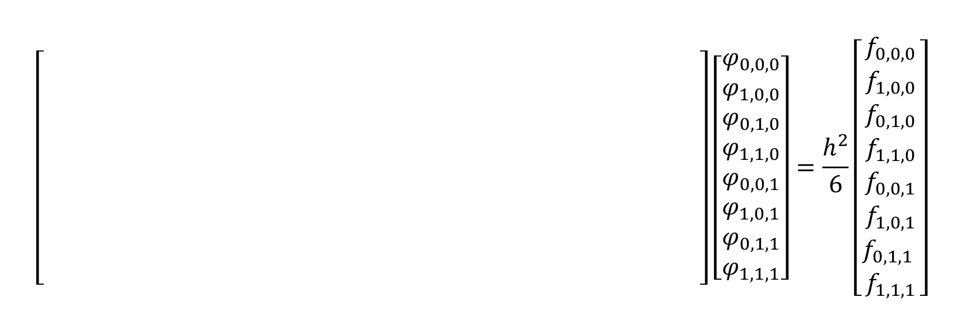
3-D Poisson’s equation
$$φ_{x,y,z}−\frac{1}{6}\left(φ_{x+1,y,z} +φ_{x−1,y,z}+φ_{x,y+1,z}+φ_{x,y−1,z}+φ_{x,y,z+1}+φ_{x,y,z−1}\right)=\frac{h^{2}}{6}f\left(x,y,z\right)$$
Example with two points on X, Y and Z:
$$\left[\begin{matrix}1 & −1/6 & −1/6 & 0 & −1/6 & 0 & 0 & 0 \\ −1/6 & 1 & 0 & −1/6 & 0 & −1/6 & 0 & 0 \\ −1/6 & 0 & 1 & −1/6 & 0 & 0 & −1/6 & 0 \\ 0 & −1/6 & −1/6 & 1 & 0 & 0 & 0 & −1/6 \\ −1/6 & 0 & 0 & 0 & 1 & −1/6 & −1/6 & 0 \\ 0 & −1/6 & 0 & 0 & −1/6 & 1 & 0 & −1/6 \\ 0 & 0 & −1/6 & 0 & −1/6 & 0 & 1 & −1/6 \\ 0 & 0 & 0 & −1/6 & 0 & −1/6 & −1/6 & 1\end{matrix}\right]\left[\begin{matrix}φ_{0,0,0} \\ φ_{1,0,0} \\ φ_{0,1,0} \\ φ_{1,1,0} \\ φ_{0,0,1} \\ φ_{1,0,1} \\ φ_{0,1, 1} \\ φ_{1,1,1}\end{matrix}\right]=\frac{h^{2}}{6}\left[\begin{matrix}f_{0,0,0} \\ f_{1,0,0} \\ \begin{aligned}f_{0,1,0} \\ f_{1,1,0} \\ f_{0,0,1} \\ f_{1,0,1} \\ f_{0,1,1} \\ f_{1,1,1}\end{aligned}\end{matrix}\right]$$
$$\left[\begin{matrix} & & & & & & & \\ & & & & & & & \\ & & & & & & & \\ & & & & & & & \\ & & & & & & & \\ & & & & & & & \\ & & & & & & & \\ & & & & & & & \\ & & & & & & & \end{matrix}\right]\left[\begin{matrix}φ_{0,0,0} \\ φ_{1,0,0} \\ φ_{0,1,0} \\ φ_{1,1,0} \\ φ_{0,0,1} \\ φ_{1,0,1} \\ φ_{0,1, 1} \\ φ_{1,1,1}\end{matrix}\right]=\frac{h^{2}}{6}\left[\begin{matrix}f_{0,0,0} \\ f_{1,0,0} \\ \begin{aligned}f_{0,1,0} \\ f_{1,1,0} \\ f_{0,0,1} \\ f_{1,0,1} \\ f_{0,1,1} \\ f_{1,1,1}\end{aligned}\end{matrix}\right]$$

Slide 4
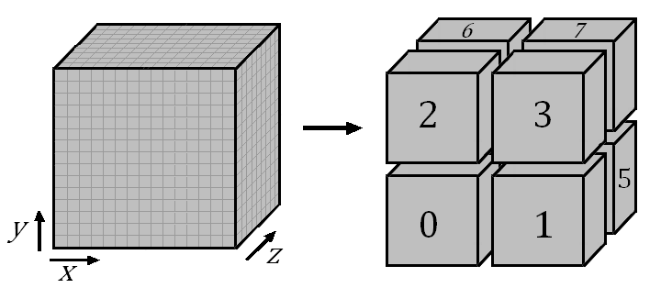
Topology
Need to split A, X and B
A can be ignored
X is initially 0
B can be calculated locally
Split the coordinates

Slide 5
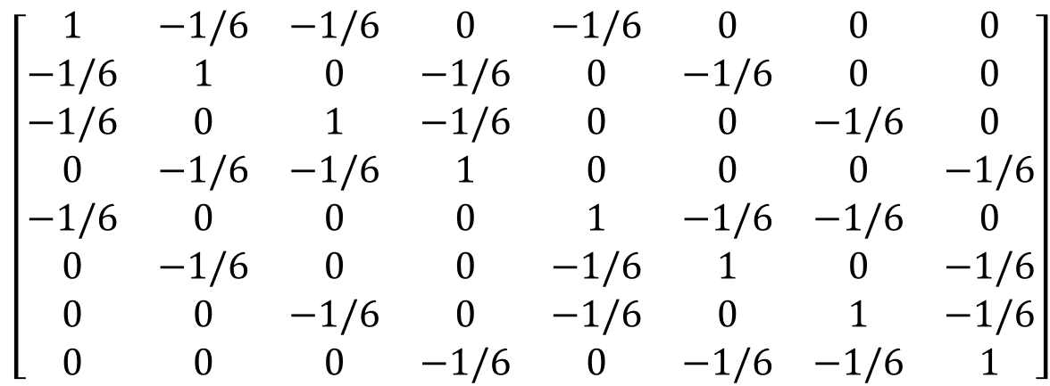
Conjugate Gradient
Non-transitive iterative method solving
Required symmetric and positive-definite matrix
Composed of 4 steps:
Determining the gradient
Determining the direction
Determining the coefficient
Updating the solution vector

Slide 6
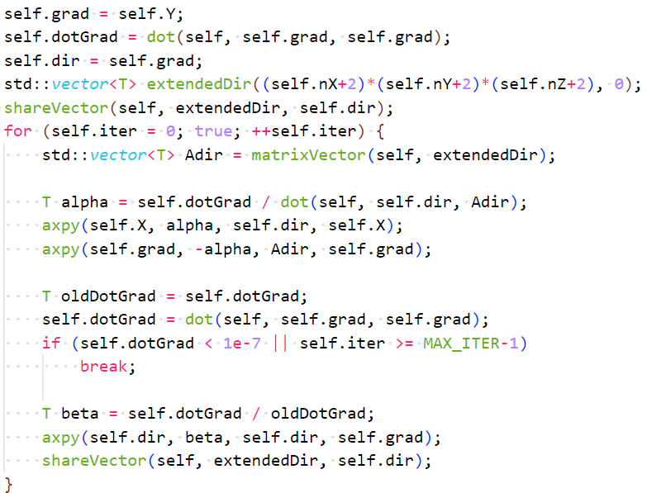
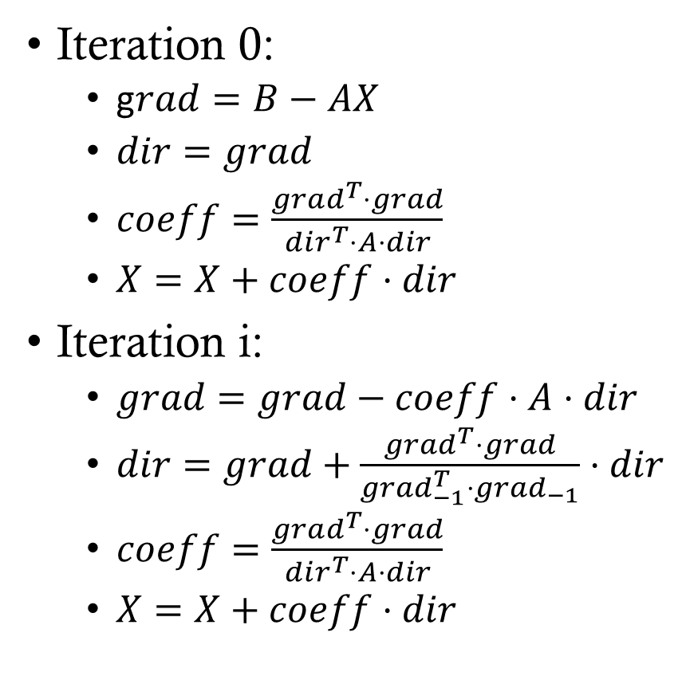
Conjugate Gradient
Iteration 0:
g$rad=B−AX$
$dir=grad$
$coeff=\frac{grad^{T}⋅grad}{dir^{T}⋅A⋅dir}$
$X=X+coeff⋅dir$
Iteration i:
$grad=grad−coeff⋅A⋅dir$
$dir=grad+\frac{grad^{T}⋅grad}{grad_{−1}^{T}⋅grad_{−1}}⋅dir$
$coeff=\frac{grad^{T}⋅grad}{dir^{T}⋅A⋅dir}$
$X=X+coeff⋅dir$

Slide 7
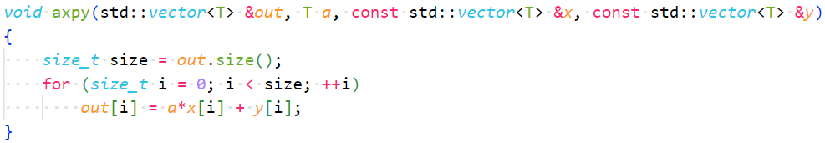
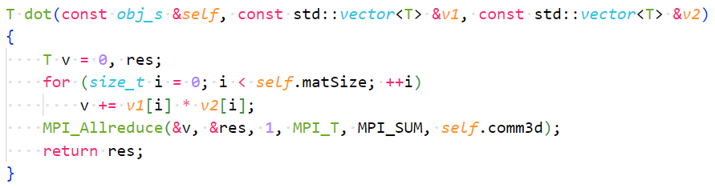
Conjugate Gradient
Vector addition:
Calculated locally
Dot product:
Calculated locally
Summed among all processes

Slide 8
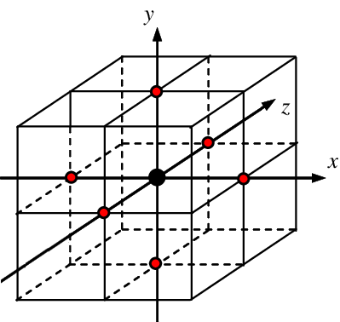
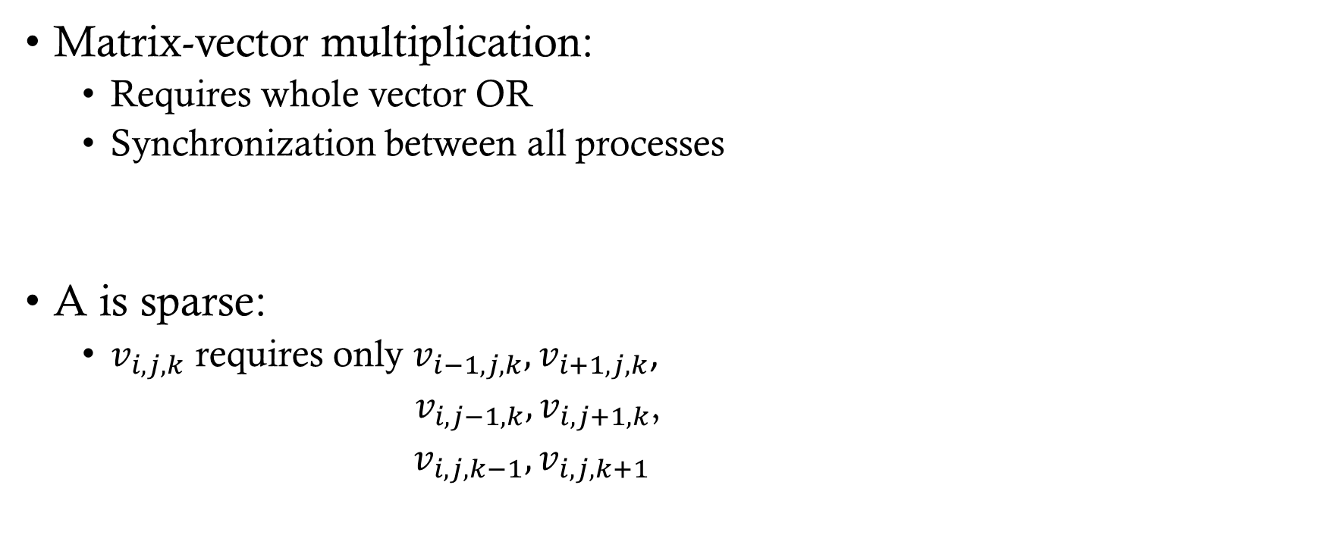
Conjugate Gradient
Matrix-vector multiplication:
Requires whole vector OR
Synchronization between all processes
A is sparse:
$v_{i,j,k}$ requires only $v_{i−1,j,k},v_{i+1,j,k}$,
$v_{i,j−1,k}, v_{i,j+1,k}$,
$v_{i,j,k−1}, v_{i,j,k+1}$

Slide 9
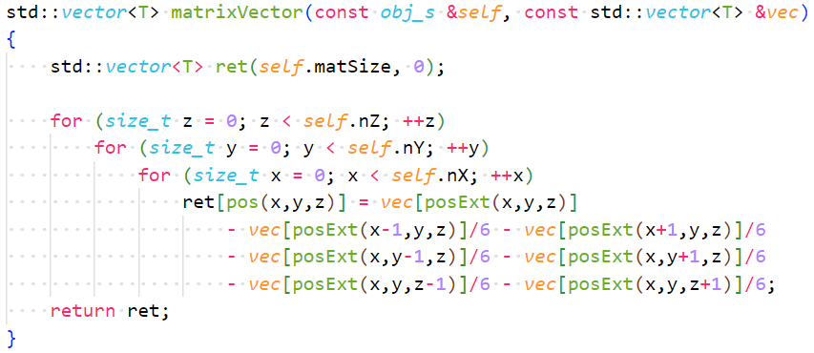

Conjugate Gradient
Using an extended $dir$ vector
Copy of $dir$ + ghost points from neighboring processes

Slide 10
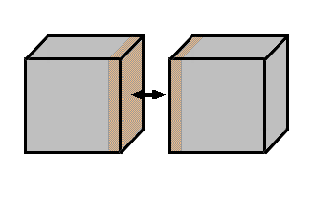
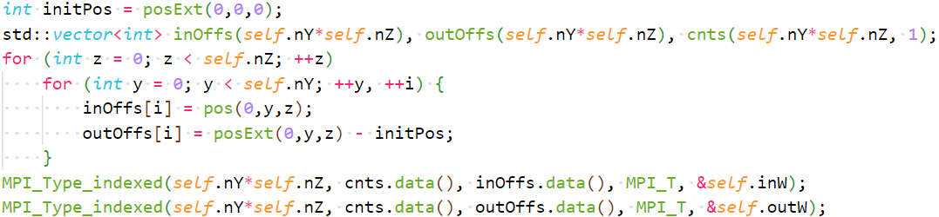
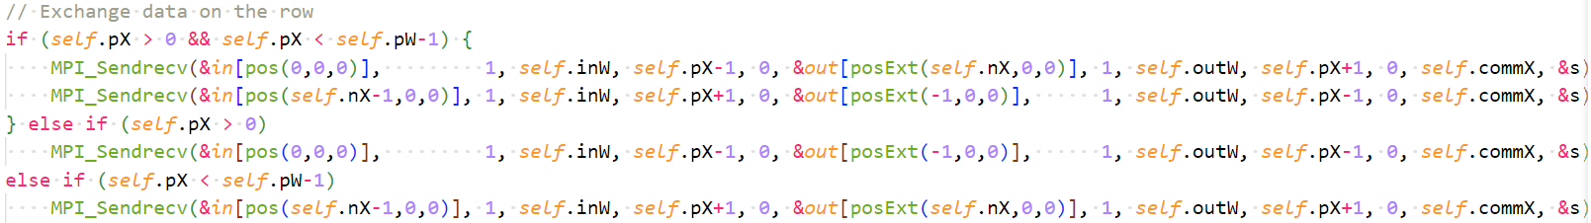
Conjugate Gradient

Slide 11
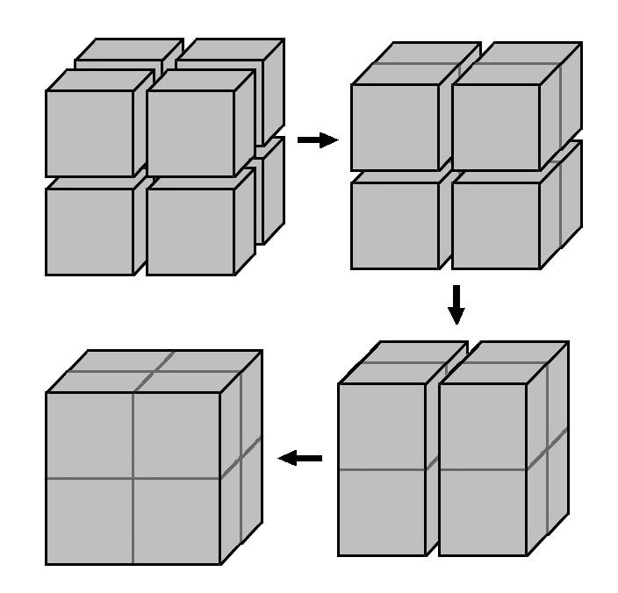
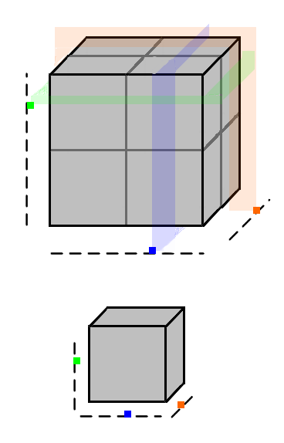

Final data access
Currently, process’ data are “appended” to each others
To access $φ\left(x,y,z\right)$ we need:
Process’ offset
Internal offset

Slide 12
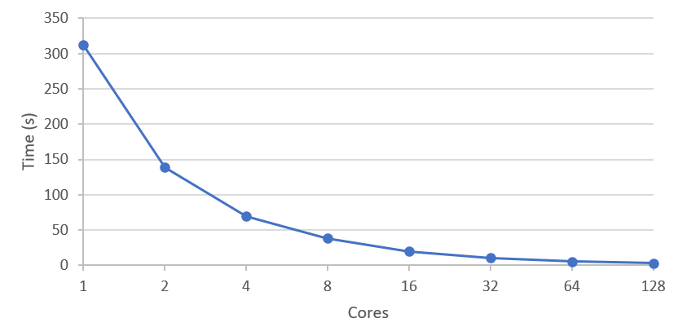
Test case: 500x500x500
Cores | Time (s) | Speed-Up | Efficiency
1 | 312.193 | 1 | 1
2 | 138.685 | 2.25 | 1.126
4 | 69.702 | 4.48 | 1.120
8 | 38.299 | 8.15 | 1.019
16 | 20.205 | 15.45 | 0.966
32 | 10.682 | 29.23 | 0.913
64 | 5.437 | 57.42 | 0.897
128 | 2.864 | 109 | 0.852

Slide 13
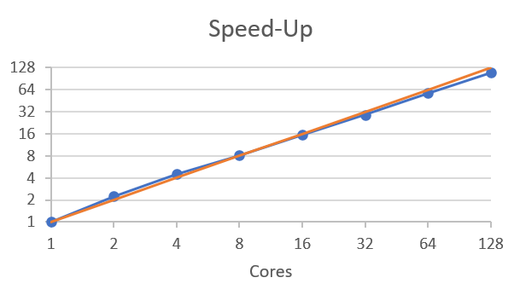
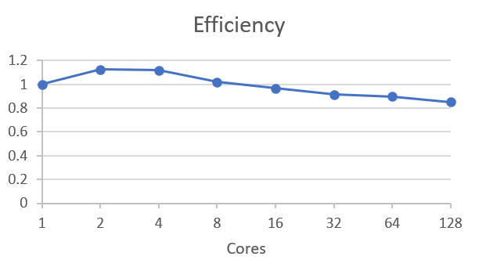
Test case: 500x500x500

Slide 14
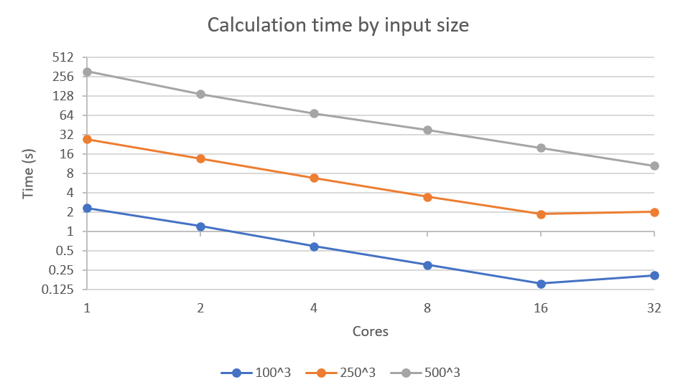
Other test cases

Slide 15
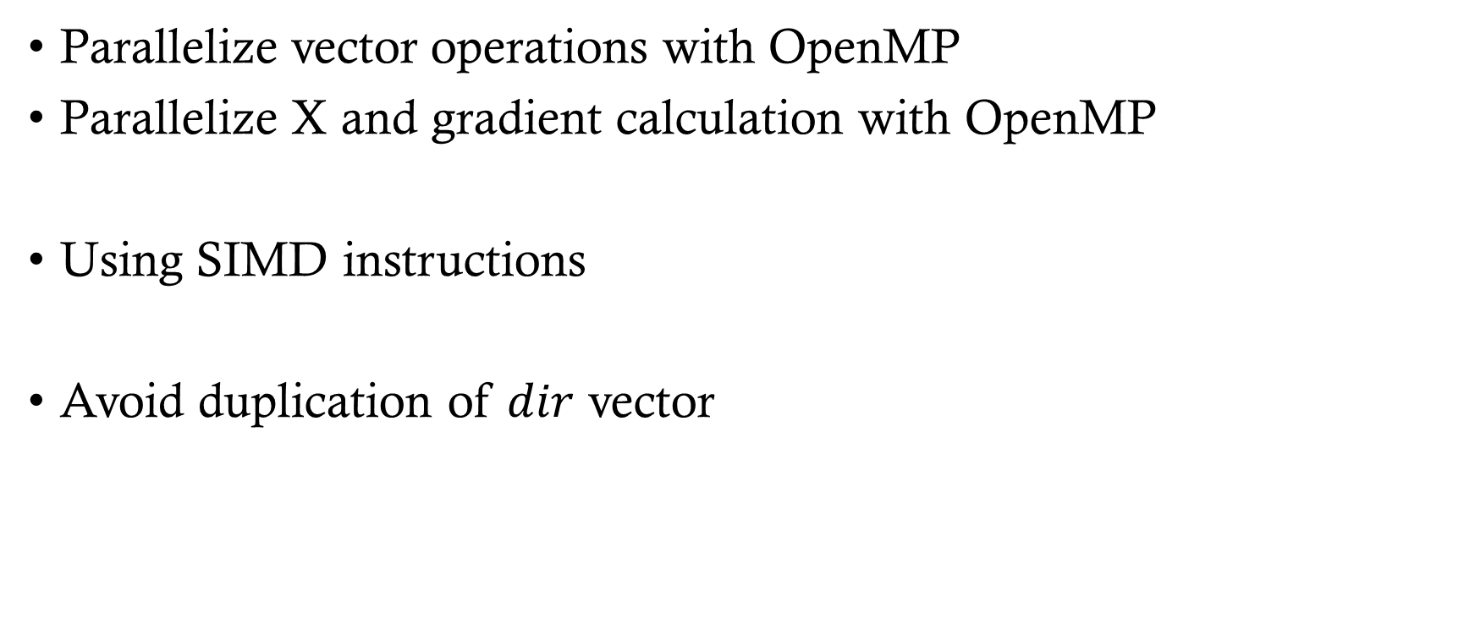
Possible improvements
Parallelize vector operations with OpenMP
Parallelize X and gradient calculation with OpenMP
Using SIMD instructions
Avoid duplication of $dir$ vector

